Slide 1
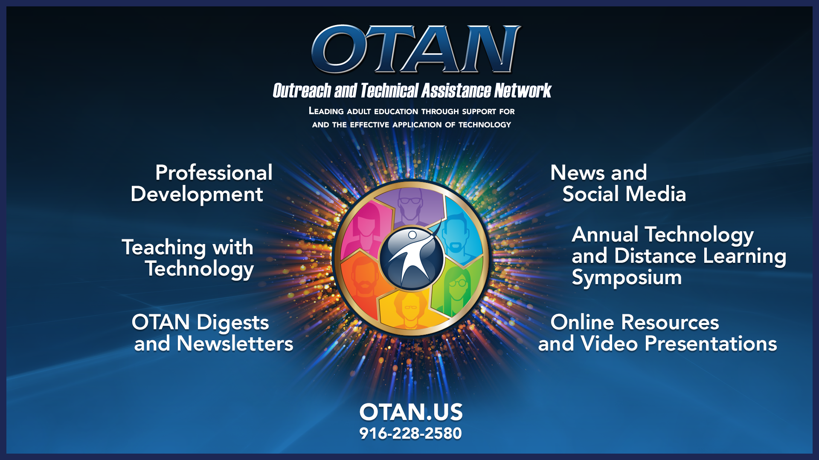
OTAN Resources

Slide 2

Welcome to Chapter 6!
Data-Driven Instruction and Digital Assessments

Slide 3
Session Objectives
Today’s Goals
Identify and evaluate digital assessment tools based on curriculum demands and the needs of adult learners
Design a sample digital assessment considering factors like learner accessibility, question types, and feedback mechanisms
Notes:
🕧 = 1 minute
Welcome the group to the session on key concepts of designing effective blended learning experiences and utilizing digital tools to create engaging and accessible learning environments for adult learners
Introduce today’s focus = data driven instruction and assessment
Review today’s objectives:
Identify and evaluate digital assessment tools based on curriculum demands and the needs of adult learners.
Design a sample digital assessment considering factors like learner accessibility, question types, and feedback mechanisms.

Slide 4





Session Agenda
Reflect on our experience with digital assessments
Review digital assessment tools
Discuss equity and accessibility in digital assessment
Engage in a digital assessment scavenger hunt
Explore next steps
Notes:
🕧 = 1 minute
Today’s agenda includes opportunities to understand key aspects of digital assessment, to share our insights and experiences, and to apply these concepts into our teaching practices.
Warm-up: Initiate an activity where participants share their current methods of assessment and experiences with digital tools.
Overview of Digital Assessment Tools: Provide a brief overview of various digital assessment tools and their unique features, strengths, and limitations.
Group Discussion: Facilitate a conversation around students' accessibility needs and considerations when choosing digital tools.
Application Activity: Guide participants in a "Digital Assessment Scavenger Hunt," where they explore different digital tools, select one, and present how it would serve their students and curriculum.
Q&A and Wrap-up: Address questions, facilitate final discussions, and remind participants of the additional resources available for their ongoing learning journey.

Slide 5

Quick Brainstorm
Think-Pair-Share
If you could create a dream digital assessment tool with all the features you find most beneficial for your teaching style and your students' needs, what three key features would it have and why?
E.g., multiple question formats, mobile-friendly
🗨️ Post your response to this Padlet
Notes:
🕧 = 5 minutes
🗣️ Facilitation tip. The purpose of this warm-up activity is to foster a collaborative and supportive environment, encouraging open dialogue and knowledge-sharing. There is no “right” or “wrong” answer, which is important to emphasize.
Start by discussing ideal digital assessment tool and its key features.
Share thoughts on a Jamboard, tapping into collective experiences as educators.
💻 Digital tools connection. Before the session, set-up the Padlet add its link/code to the speaker notes, and on the slide for easy access.
Here’s a Padlet tutorial (link below)*.
📃 You can also make a copy of and use a template (link below)*.
🗣️ Facilitation tip. It may be helpful to define what is meant by “features” and/or provide a few examples:
Definition: An attribute or aspect of a product or tool
Examples: Auto-grading, multi-media integration, multiple question formats, mobile-friendly, accessibility support, interactive elements, integration with LMS, security features, feedback mechanisms
🗣️ Facilitation tip. Once participants post their responses, spend time highlighting thought-provoking ones without suggesting any response as correct. Ask participants to elaborate on their responses, encouraging further engagement. For example:
"That's interesting,"
"Has anyone experienced something similar?",
"That's insightful."
💻 Digital tools connection. Participants can also use emojis to react to responses from their peers.
Links:
Padlet Tutorial: https://padlet.help/l/en/article/9j9aadt8tn-how-do-i-get-started-with-padlet
Padlet Template: https://padlet.com/OTANTraining/remake-link/pmywv9ln1EBZXGA8

Slide 6
Formative Versus Summative
Formative assessments
Ongoing assessments designed to provide immediate feedback to help students improve learning to teachers for improving instruction
  Examples: CASAS pre-test, exit tickets, think-pair-share
Summative assessments
End-of-course or program assessments designed to evaluate learning at the end of an instructional period
  Example: CASAS post-test, final project, GED
Notes:
🕧 = 3 minutes
This is a content delivery slide for introducing key concepts to the group.
Consider asking the group what they understand to be the difference between formative and summative assessments prior to defining the differences.
🗣️ Facilitation tip. Then, make connections between what participants say and the notes on the slides and in the speaker notes.
Formative assessments are ongoing assessments, reviews, and observations in a classroom. They provide immediate feedback, both to students for improving their learning and to teachers for improving their instruction. While they're beneficial for the continuous monitoring of student progress, they can sometimes lack the rigor and structure of other assessment types.
Summative assessments evaluate student learning at the end of an instructional period. They're often high stakes, which means they have a high point value. Examples of summative assessments include final projects, exams, and papers. They provide a clear endpoint and summary of student progress, but might not provide timely feedback that could assist in ongoing learning.
🗣️ Facilitation tip. Emphasize that standardized and performance-based assessments can be used as either formative or summative.

Slide 7
Standardized Assessments
The Pros and Cons
Designed to measure understanding against a standard set of knowledge. Test takers are given the same questions under the same conditions.
Pros
Efficient
Measure progress at individual and group level
Provide a common metric and language
Validated by psychometricians
Cons
Lack flexibility
Can sometimes miss individual learner’s growth or unique strengths
Can cause anxiety due to high stakes
Can be influenced by test-taking abilities
Notes:
🕧 = 1 minute
Standardized assessments are a type of assessment where all test takers are given the same questions under the same conditions. These assessments are primarily designed to measure a learner's understanding against a standard set of knowledge.
:Provide examples of Adult Education standardized assessments include:
GED, HiSET
TABE, CASAS
U.S. Citizenship Exam
🗣️ Facilitation tip. Consider asking for participants to share initial ideas on pros and cons as you then talk through some of the following list:
Pros
They are efficient
Allow for comparison across groups and instructional settings
Provide a common metric and common language
Psychometricians work carefully to design and validate these assessments, ensuring they accurately measure learning outcomes.
Cons
Lack flexibility
May not account for individual learning scenarios and application of skills.
May cause anxiety among learners due to high stakes attached.
Could be influenced by a student's test-taking abilities

Slide 8

Performance-based Assessments
The Pros and Cons
Evaluations that require learners to demonstrate specific skills and competencies through performing a task or completing an activity related to the learning objectives.
Pros
Authentic evaluation
Demonstrates mastery
Cons
Time-consuming
Subjectivity of evaluator
Notes:
🕧 = 1 minute
Performance-based assessments measure a learner's ability to apply the skills and knowledge gained from a course. They can take the form of presentations, group projects, or practical tasks. These types of assessments allow for creativity and real-world application, however, they can be more time-consuming to assess and may require clear rubrics to ensure fair scoring.
Share examples of Adult Education performance-based assessments
Role-Plays and Class Discussions: In ESL, role-plays where students must navigate real-world situations (like job interviews, doctor's appointments, or buying groceries) in English can be an effective assessment tool. In GED contexts, role-plays might be designed around subject matter like social studies (participating in a mock trial or debate).
Projects/Presentations: For example, ESL students might research and present on a topic using English, while GED students could be assessed on a project related to one of the four subject areas of the GED (math, science, social studies, and Reasoning Through Language Arts).
Portfolios: A portfolio is a collection of a student's work over time. For GED students, portfolios could include a variety of tasks such as essays, problem-solving exercises, or other subject-specific tasks. In ESL classes, portfolios could include written work, recordings of spoken English in different situations, or self-assessments of language progress.
Note some of the pros and cons with more detail
Pros
Authentic Evaluation: These assessments provide a more authentic measure of learners' understanding, as they simulate real-world tasks or situations.
Demonstrates Mastery: They allow for the demonstration of mastery and the application of knowledge and skills, going beyond mere recall of facts.
Cons
Time-Consuming: Designing, implementing, and evaluating performance-based assessments can be more time-consuming than traditional assessments.
Subjectivity: These assessments can be more subjective due to their often qualitative nature, potentially leading to inconsistencies in scoring or evaluation.

Slide 9

Other Assessment Tools
Discussion
Gamification
Polling
Quizzes
Portfolios
Notes:
🕧 = 3 minutes
Provide an overview of different types of other, sometimes informal, assessment models.
🗣️ Facilitation tip. Be sure to emphasize that the best educational programming typically leverages several types of assessments and performance data, including standardized tests, teacher observations, and the assessment models listed here
Discussion: This is a learning activity where learners exchange ideas and opinions on a specific topic to deepen their understanding and application of the material.
Gamification: This refers to the application of game design elements in non-gaming contexts, used in education to increase engagement, motivation, and retention through elements like badges, competitions, or point systems.
Polling: A real-time method used by educators to check learners' understanding during or after instruction, utilizing digital tools that offer various question types such as multiple-choice, open-ended responses, and word clouds.
Quizzes: These are assessment tools that educators can create or modify using various platforms to test learners' understanding of a topic, often including multimedia content, links to external sites, and auto-grading capabilities.
Portfolios: A collection of learner's work, often digital, showcasing their growth and learning process, including assignments, projects, and other learning artifacts, typically coupled with some form of reflection, either text-based or audio-visual.

Slide 10
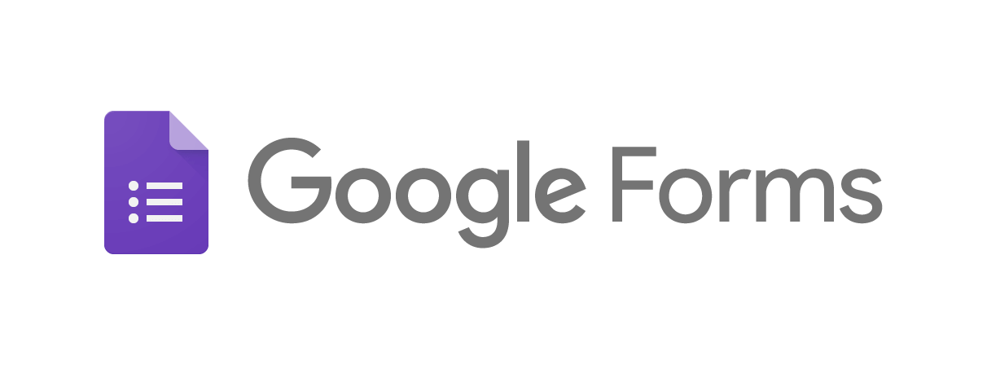





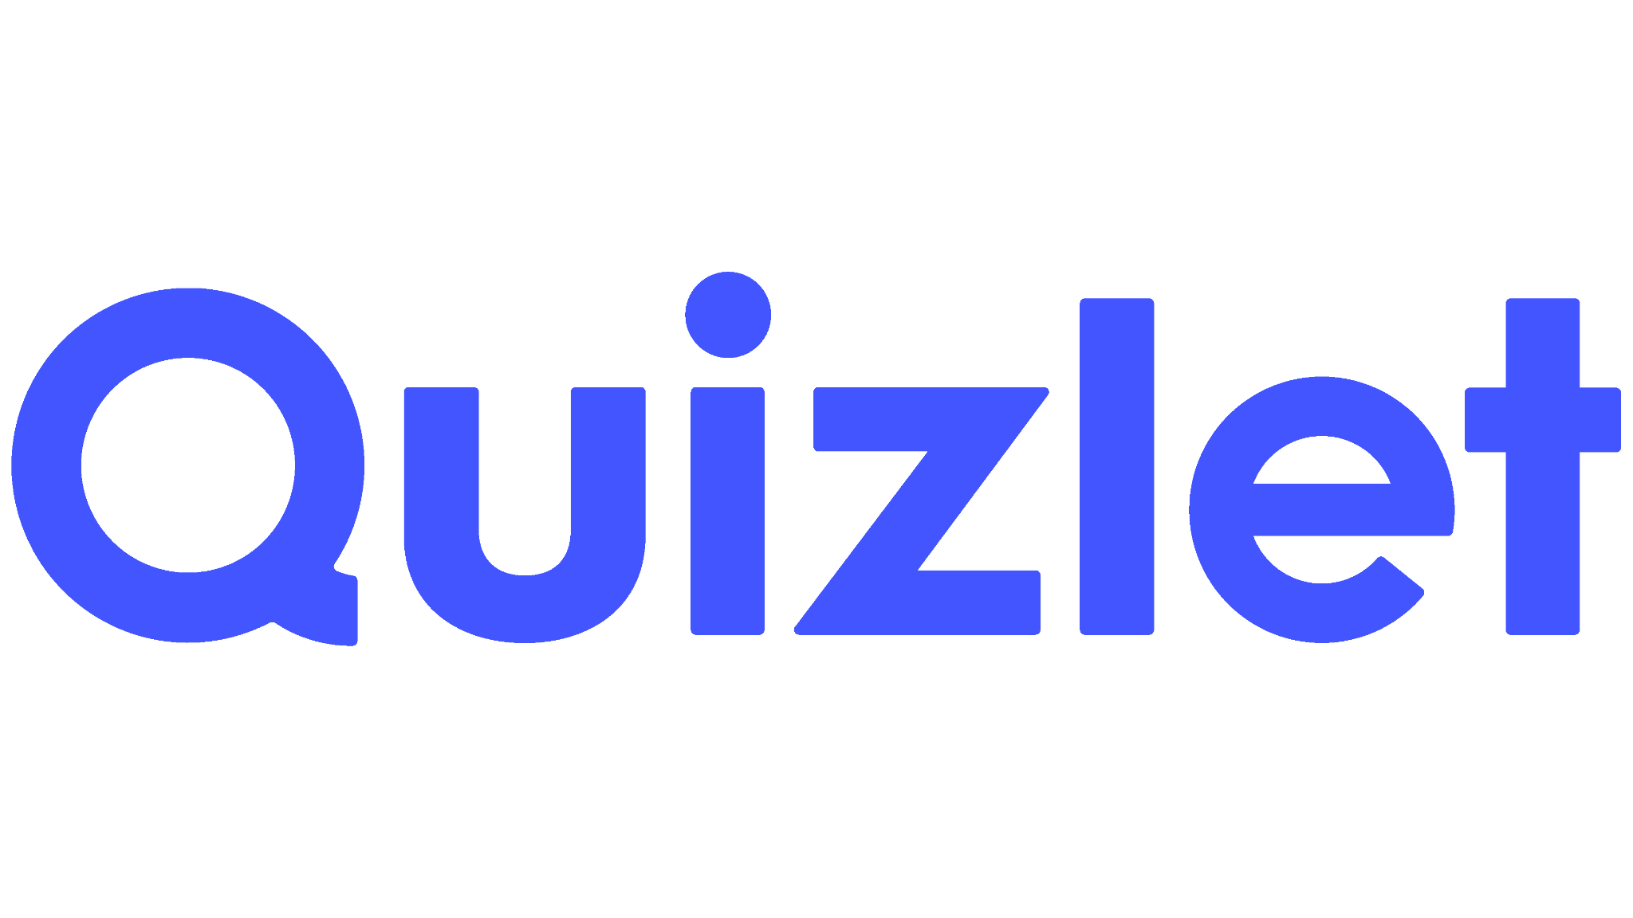

Overview of Digital Assessment Tools
Notes:
🕧 = 3 minutes
Digital assessment tools and platforms each have unique features that can enhance assessment strategies. When selecting a tool, it's important to consider factors like learner accessibility, the types of questions you'll be asking, and the feedback mechanisms available.
A sample of a few options include:
Google Forms: A versatile tool that can be used to create quizzes, surveys, and feedback forms with various question types and automatic grading.
Kahoot!: An interactive platform that allows teachers to create fun, game-based quizzes for formative assessment.
Quizlet: A digital tool for creating flashcards and quizzes, perfect for vocabulary drills or quick comprehension checks.
Socrative: A classroom app for fun, effective formative assessment with quizzes, quick question polls, exit tickets, and space races.
Padlet: An online virtual bulletin board where students can express their thoughts on a common topic, useful for brainstorming, collaborative projects, and formative assessment.
Mentimeter: This interactive presentation tool allows you to create fun and interactive presentations. You can use it to create quizzes, polls, Q&A sessions, and much more.
Flip: A video discussion platform where students can respond to prompts, share their thoughts, and engage with their peers, useful for formative assessment and reflection.
Nearpod: An interactive teaching tool that allows for the creation of comprehensive lessons with quizzes, polls, and interactive drawings to collect formative data.
Microsoft Forms: Similar to Google Forms, it allows teachers to create quizzes, surveys, and polls with automatic grading and integrates seamlessly with other Microsoft tools.

Slide 11

Considerations When Choosing Tools
Considerations for Digital Tool Selection
User-friendly and intuitive
Mobile-friendly and low-bandwidth functionality
Diversity of student needs
Assessment types
Notes:
🕧 = 5 minutes
Prior to defining features, consider opening the jamboard from the warm-up activity to review they key features of dream digital assessment tools shared by participants.
Then, draw connections between those features and the notes on the slide and in speaker notes.
Exploring the many digital assessment tools like Kahoot, Quizlet, Google Forms, Padlet, and many others can seem overwhelming at first.
However, focusing on your students' needs and your curriculum requirements can guide you to the best tool for your situation.
While exploring, remember to prioritize accessibility - some of your students might have limited access to high-speed internet or computers, making mobile-friendly and low bandwidth tools essential.
When choosing a digital assessment tool, think about your students' accessibility needs.
Is the tool user-friendly and intuitive for both you and your students?
Does the tool offer mobile-friendly options and function well on low bandwidth?
Can the tool cater to the diverse needs of your students (i.e., different learning scenarios, accessibility requirements)?
Does the tool allow for different types of assessments (e.g., quizzes, polls, discussion forums, portfolio submissions)?
How does the tool support feedback and grading? Is there an automated grading feature?

Slide 12
Discussion
Exploring Digital Assessment Tools and Experiences
When was a multiple-choice quiz effective in its use as an assessment, and when did it fall short?
Reflecting on your own experience, when did you provide feedback to students that produced significant results in their work? What did that feedback look like?
  Meaningful feedback provides information that is specific and personalized to the individual learner.
Notes:
🕧 = 5 minutes
Ask participants to recall a specific instance of when a multiple choice quiz effective in its use as an assessment, and when did it fall short?
Invite participants to share their experiences and discuss how they would approach it differently now.
Next, encourage educators to consider the concept of 'useful feedback'. Ask:
When was a multiple choice quiz effective in its use as an assessment, and when did it fall short?
Reflecting on your own experience, when did you provide feedback to students that produced significant results in their work? What did that feedback look like?
During the discussion, ensure that each participant has an opportunity to share their thoughts and experiences. Offer insights or ideas based on the shared experiences to promote a deeper understanding of the discussion topics.
To wrap up this activity, summarize the key points from the discussion and highlight how these insights can influence their future choices of digital assessment tools.
Remind participants to keep these considerations in mind when they explore digital tools in the upcoming 'Scavenger Hunt' activity.

Slide 13
Reporting on Digital Assessment Tools
Guiding Questions for Digital Tool Selection
Is the tool user-friendly and intuitive for both you and your students?
Does the tool offer mobile-friendly options and function well on low bandwidth?
Can the tool cater to the diverse needs of your students (i.e., different learning styles, accessibility requirements)?
Does the tool allow for different types of assessments (e.g., quizzes, polls, discussion forums, portfolio submissions)?
How does the tool support feedback and grading? Is there an automated grading feature?
Notes:
🕧 = 20 minutes: (for the full activity on slides 13-15)
Groups can use the Slides template for sharing an overview of their digital assessment tool
As groups present their findings, the slides template can be projected on screen to offer a visual reference to guide the presentation and conversation

Slide 14

Getting Started with the Scavenger Hunt
Activity: Explore a digital assessment tool and evaluate its efficacy against various features.
Example: Google Forms
User-friendly and intuitive
Mobile-friendly
Types of assessments
Feedback and grading
Notes:
🕧 = 20 minutes: (for the full activity on slides 13-15)
Directions for the activity
Participants will engage in a "Digital Assessment Scavenger Hunt."
In small breakout groups, they are given a list of assessment features (such as mobile-friendly, supports multiple question formats, has automated feedback, etc.) and then have to find a digital tool that supports these features.
📃 You can make a copy of this template (link below)* to guide the activity.
[Add the sharable link here] or add a QR code to the slide so everyone can access your slide.
Each group can then share their chosen tool, its features, and a brief explanation of how they'd use it for assessment in a hypothetical lesson or unit.
Instructions are found on Slide 15
Links:
Google Slides Template: https://docs.google.com/presentation/d/1M0cJnO4PIkO2XSwvahpT44vvR3Dvh-VcoR7E7PMihQI/copy

Slide 15
Activity Directions
Getting Started with the Scavenger Hunt
Breakout into small groups.
Find a digital assessment tool and evaluate it against these questions:
  Is the tool user-friendly and intuitive for both you and your students?
  Does the tool offer mobile-friendly options and function well on low bandwidth?
  Can the tool cater to the diverse needs of your students (i.e., different learning styles, accessibility requirements)?
  Does the tool allow for different types of assessments (e.g., quizzes, polls, discussion forums, portfolio submissions)?
  How does the tool support feedback and grading? Is there an automated grading feature?
Discuss your chosen tool and how you'd use it in a hypothetical lesson or unit.
Prepare a brief presentation to share your findings.
Notes:
🕧 = 20 minutes: (for the full activity on slides 13-15)
🗣️ Facilitation tip. Provide guiding questions and this slides template for participants to take notes and develop their short “pitch” or presentation
📃 You can make a copy of and share the template below* to guide the activity.
Guiding questions to talk through
Is the tool user-friendly and intuitive for both you and your students?
Does the tool offer mobile-friendly options and function well on low bandwidth?
Can the tool cater to the diverse needs of your students (i.e., different learning styles, accessibility requirements)?
Does the tool allow for different types of assessments (e.g., quizzes, polls, discussion forums, portfolio submissions)?
How does the tool support feedback and grading? Is there an automated grading feature?
Links:
Google Slides Template: https://docs.google.com/presentation/d/1M0cJnO4PIkO2XSwvahpT44vvR3Dvh-VcoR7E7PMihQI/copy

Slide 16

What’s Next?
Chapter 6 of the Digital Learning Guidance provides more details and discussion of key principles
The self-paced course on the OTAN website includes a multiple-choice quiz and extension activities
Continue finding opportunities to simplify program materials to improve readability and accessibility.
Notes:
🕧 = 5 minutes
Today, we explored Ch 6 of the Digital Learning Guidance, which looks at the benefits and considerations of digital assessment tools and various assessment types. We also completed a scavenger hunt to discover the features and applications of these tools in creating meaningful and accessible assessments for students.
As a quick overview of key concepts:
Digital assessment tools, like Kahoot, Quizlet, Google Forms, and Padlet, offer unique features, strengths, and limitations, influencing their effectiveness in different teaching scenarios.
Various forms of assessments, including standardized, performance-based, formative, and summative, serve different purposes in the learning process.
Factors such as learner accessibility, question types, and feedback mechanisms should be considered when selecting a digital assessment tool.
Mobile-friendly digital tools that work well on low bandwidth are crucial for accessibility and inclusivity.
Diverse digital tools can cater to different types of assessments and offer various ways for students to demonstrate their understanding, making learning more dynamic and engaging.

